Slide 1
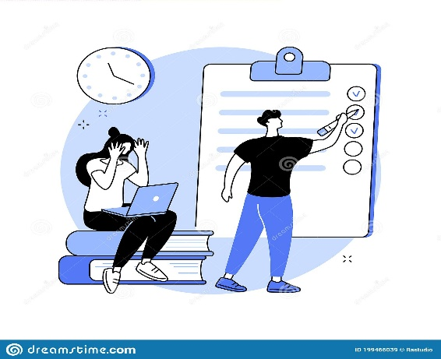
2ème BAC PC INT
Horaires Jours | S1 (8:30—11:30) | S2 (12:00--14H00)
JEUDI 26/05/2022 | PC | ANG
VENDREDI 27/05/2022 | MATHS | PHILO
SAMEDI 28/05/2022 | SVT
Planning SIMILI BLANC

